Slide 1

The
Mohanty
Quiz

Slide 2
1
The origin of a certain phrase may have come from a Greek expression catadoxa which means ‘contrary to experience/belief’.
An occurrence of this phrase might be linked to a Jonathan Swift poem describing the phenomenon in the phrase
Drowned ________, stinking sprats, all drenched in mud,
Dead _____ and turnip-tops come tumbling down the flood.
Which Phrase?

Slide 3
2
X was originally invented in 1974 by an Hungarian sculptor and professor of architecture.
It was initially built as a teaching tool to help students understand 3D objects, and how parts could be moved independently without the entire mechanism coming apart.
It was almost named ‘The Gordian Knot’ in reference to the Ancient Greek legend of a knot so tightly entangled that it was impossible to see how it was fastened
ID X

Slide 4
3
A Cryptocurrency with the tagline “The One Token that Rules them All” launched in August 2021 with a video endorsement from Billy Boyd that promised users a ‘Journey through Risk and Reward’
A certain legal entity argued (rightfully) that the name of the token infringed on trademark and claimed that the name was specifically designed to mislead users into believing the rights had a connection to the entity.
What was the apt name of this token, a pun on the name of the entity?

Slide 5

4
ID the place

Slide 6

5
In Feb 2022, the city of Birmingham, Alabama ran campaign in honor of a defiant act from the 20th century, but chose poorly the placement of these ads.
Who is the remembrance for?

Slide 7
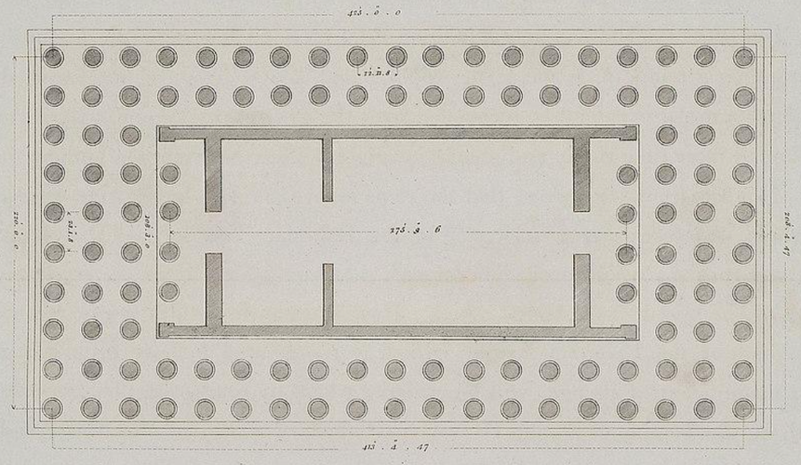
6
Floor plan of which historical monument, the biggest of its type which also had a twin monument

Slide 8
7
This company started out by mailing it’s products back in 1998. The envelopes were first white and then yellow, but settled on the iconic red since 2001.
Though this company has long pivoted to a different means of product delivery, the last envelope was mailed in September of this year, with the company informing the customers that there was no need to return them
Which company?

Slide 9
8
The study that won the 2012 Ig Nobel in Fluid Dynamics investigated a common, quite annoying occurrence that had at the time never undergone comprehensive investigation.
They studied the circumstances that lead to liquid dispersion from a container, by testing out different velocities of biomechanical locomotion and initial fluid levels, which when combined with the low-viscosity of the fluid, leads to the annoying (everyday) occurrence.
Which phenomenon did they study ?

Slide 10

9
In the Phineas and Ferb episode titled “The Lake Nose _______”, Dr. Doofenshmirtz attempts to remove all the Zinc from Lake Nose which results in an entity becoming weaker and worn out as it requires Zinc for its sustenance.
Phineas and Ferb find this entity and befriend it. At the end of the episode, Candace accuses her brothers of not bringing the proof of the the entity’s existence to make her look foolish.
Which famous real life entity is the title a pun of?

Slide 11


Slide 12

10
A novel from Walter Tevis first came out in 1982, but only became a New York Times’ bestseller after more than 3 decades of its release.
This surge in popularity came about because of a successful screen adaptation, but there have been earlier unsuccessful attempts to adapt the book, the most recent of which was supposed to be directed by Heath Ledger.
Which Novel?

Slide 13

11
The site in New Jersey of a famous 20th century mishap is today outlined with a chain and bronze plaque, which were dedicated on the 50th anniversary of the tragedy.
The event was well documented since this would’ve been a major milestone, which flocked in huge crowd.
What happened here?

Slide 15
2 pointers

Slide 16
12
Before AI generated images and collages became mainstream, Salvador Dali created a masterpiece that gives the illusion of 2 paintings in one.
Titled “Gala Contemplating the Mediterranean Sea” ; it demonstrated the low quantity of information needed to represent a recognizable individual face. The painting is a homage to America itself, giving him refuge during the turmoil of the Spanish Civil War and WW2.
ID the American face (1)
Given it’s simplified shapes & colour gradations, it’s also a homage to another painter which similar abstract style. ID the painter (1)

Slide 17

Gala Contemplating the Mediterranean Sea

Slide 18
13
Xs have always been native to India and have been a part of Indian culture for centuries.
Y was a military general who of the Portuguese established colonies in India in the 15th centuries. Naturally, the colonizers had their eyes on the native Indian X and lots were exported to Europe.
However, Y and the European elites had a different taste and they preferred their X to be firm and sweet so that they could be cut and served on the tables.
This is where the Portuguese started using the technique grafting on X plants. They would eventually stumble upon a variant that was to the liking of Y, naming the variant after him.
ID X and Y.

Slide 19
14
One of the most memorable victories of Lee Hyung-Taik, a professional tennis player, is against Goran Ivanisevic. Lee was leading 7-5, 6-7, 3-1 and victory was imminent, it was visible that Ivanisevic was running out of patience.
Ivanisevic then did something, that he had been doing a few times in this match, but little did he know that this time he couldn’t afford to do it, which led to Ivanisevic losing the match in the most embarrassing manner.
What had he been doing all match?
What was the reason for the embarrassing defeat?

Slide 20
15
The podcast "The ____ __ _______" is an exploration series hosted by two historians, Dominic Sandbrook and Tom Holland (different Tom Holland).
In each episode, they delve into a different topic in history, frequently featuring guest experts. The podcast takes its name from a familiar expression used to signify that subsequent events are widely recognized/well known and require no further elaboration.
What’s the title of the podcast?
Episode 267 of this podcast is titled ‘_____: The Roar of the Red Dragon’, which country is this episode about? (hint: not an asian country)

Slide 21
16
The Stepan Company is a chemical manufacturer and has about 2000 employees. They own a facility in New Jersey and are the only DEA authorised entity in the US to import a certain species with the intention of extracting a chemical from it, which is used for medical purposes.
After processing, the chemical-free extract is sold to a very popular company for use in its products, whose name is based the common name of this species. Which huge company is this?
What asset of this company is hidden away behind this vault? (Image follows)

Slide 22


Slide 23

17
The flag of a certain state ‘X’ of a economically prosperous country is rather weird and has a very rich history behind it. The state itself has a GDP of $600 Billion (only 20 countries have a higher GDP) because of the presence of numerous companies and industries.
One of these companies’ logo is derived from this flag, debunking the myth that the logo is resonant of the company’s aviation beginnings.
A team from this region has also incorporated this flag into its logo, after an earlier design had to be stopped because reasons.
ID the state X (1)
Which company and which team (0.5+0.5)

Slide 25
ID

Slide 26
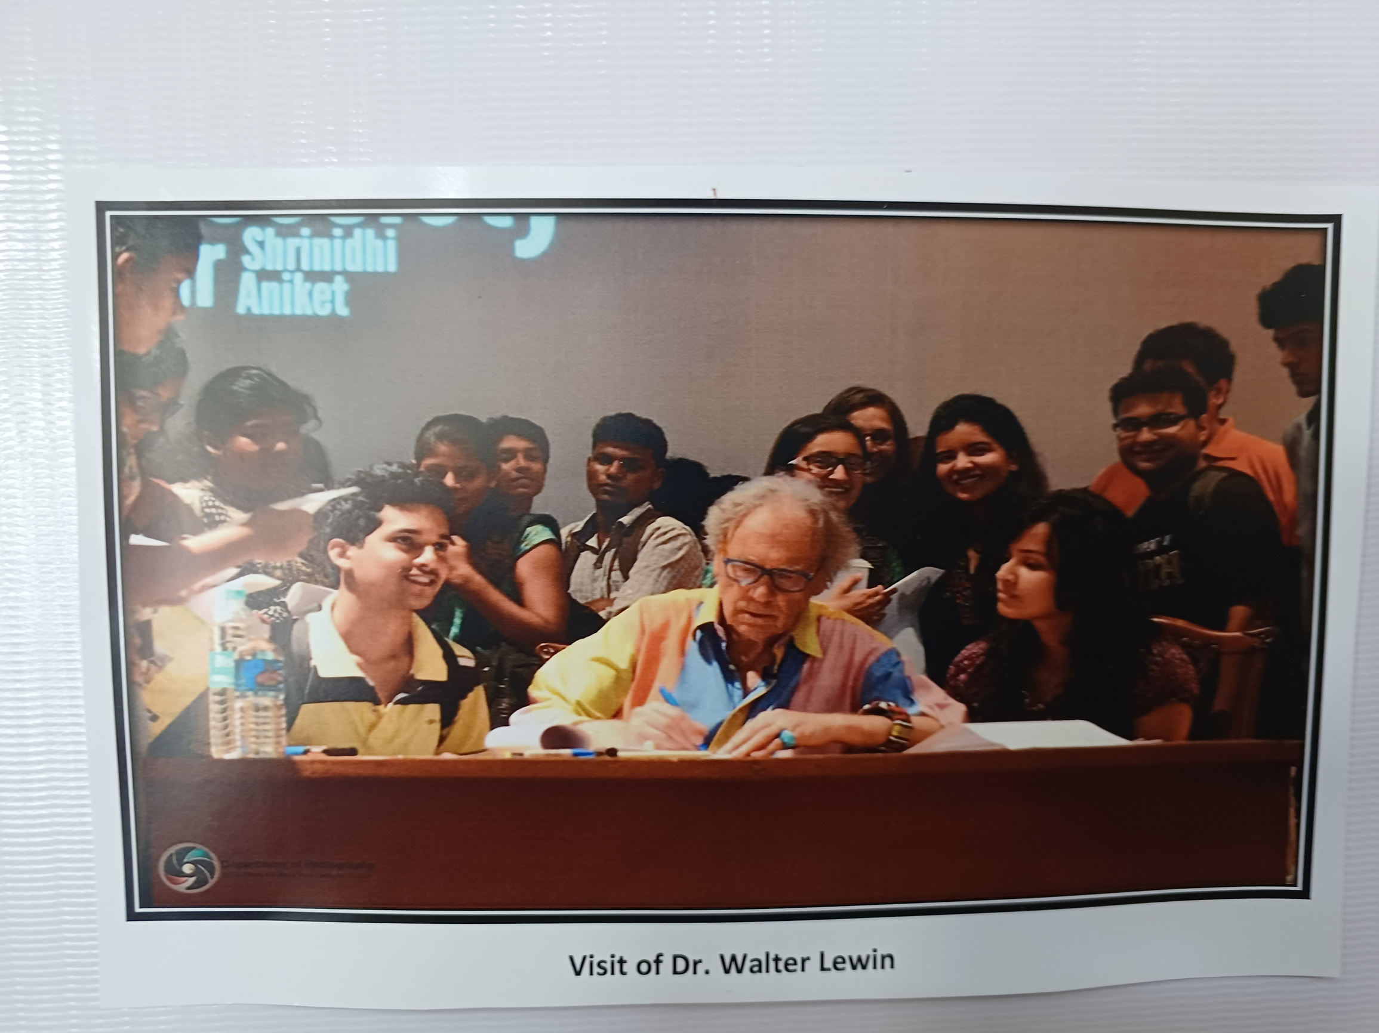
18

Slide 27
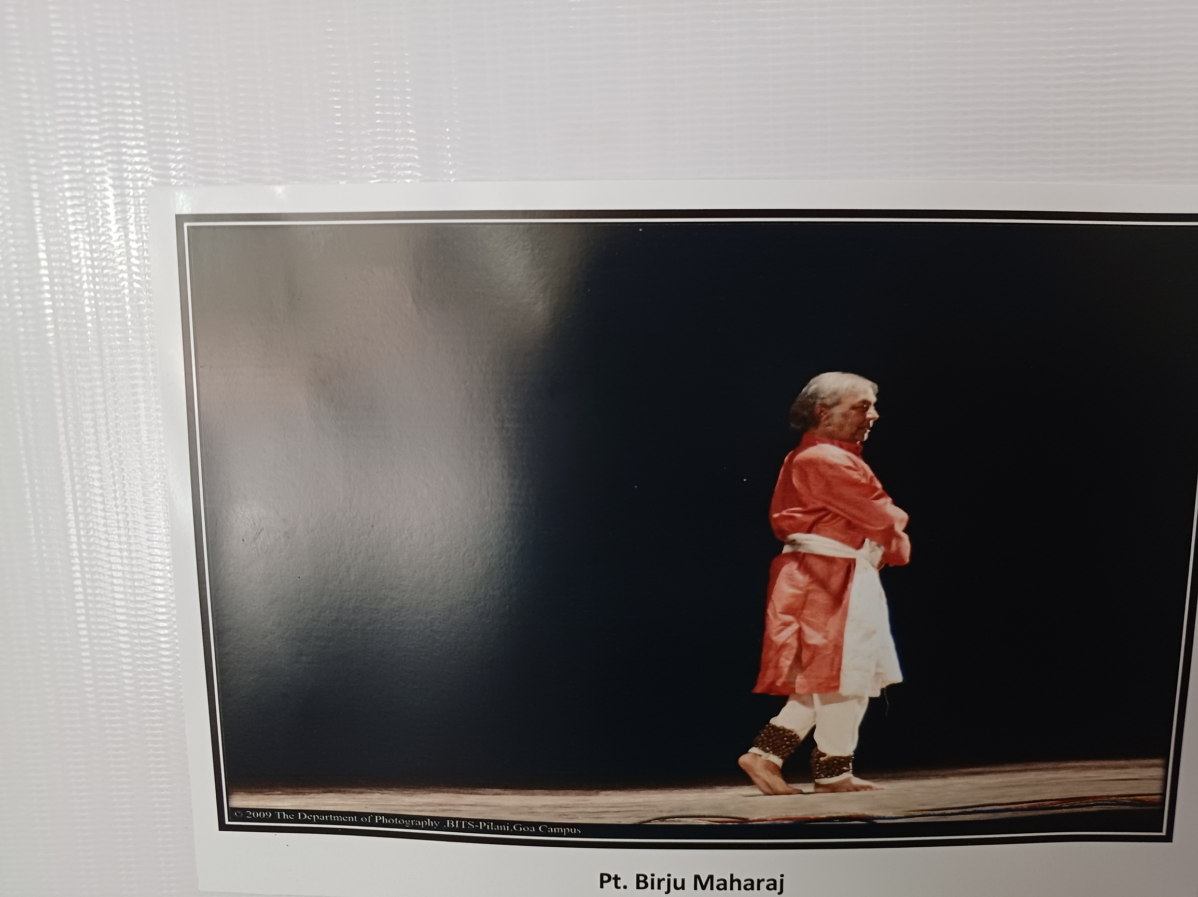
19

Slide 28

20

Slide 29

21

Slide 30
22
Joy, power, anguish, respect, pride, bravery, glory, wonder, and passion - Navarasa - illustrate the emotional spectrum experienced by fans during the drama and excitement of a global event. This led to the creation of the logo of this event.
Which event?

Slide 31
23
Shiny Happy People by R.E.M was selected as the theme song for a peppy sitcom. But the band declined and another song was chosen.
Which show? (Song follows)

Slide 32


Slide 33
Answers

Slide 34
1
The origin of a certain phrase may have come from a Greek expression catadoxa which means ‘contrary to experience/belief’.
An occurrence of this phrase might be linked to a Jonathan Swift poem describing the phenomenon in the phrase
Drowned ________, stinking sprats, all drenched in mud,
Dead _____ and turnip-tops come tumbling down the flood.
Which Phrase?

Slide 35
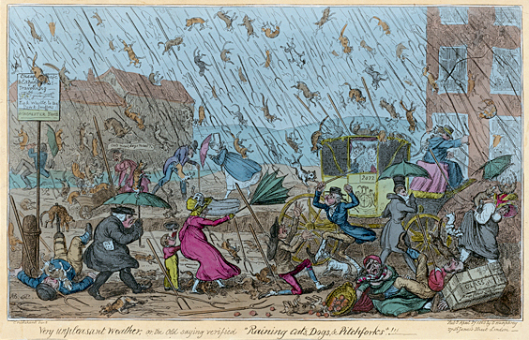
Raining Cats and Dogs
Drowned puppies, stinking sprats, all drenched in mud,
Dead cats and turnip-tops come tumbling down the flood.

Slide 36
2
X was originally invented in 1974 by an Hungarian sculptor and professor of architecture.
It was initially built as a teaching tool to help students understand 3D objects, and how parts could be moved independently without the entire mechanism coming apart.
It was almost named ‘The Gordian Knot’ in reference to the Ancient Greek legend of a knot so tightly entangled that it was impossible to see how it was fastened
ID X

Slide 37

Rubik’s Cube

Slide 38
3
A Cryptocurrency with the tagline “The One Token that Rules them All” launched in August 2021 with a video endorsement from Billy Boyd that promised users a ‘Journey through Risk and Reward’
A certain legal entity argued (rightfully) that the name of the token infringed on trademark and claimed that the name was specifically designed to mislead users into believing the rights had a connection to the entity.
What was the apt name of this token, a pun on the name of the entity?

Slide 39

JRR Token

Slide 40
4
ID the place

Slide 42
5
In Feb 2022, the city of Birmingham, Alabama ran campaign in honor of a defiant act from the 20th century, but chose poorly the placement of these ads.
Who is the remembrance for?

Slide 43

Rosa Parks

Slide 44
6
Floor plan of which historical monument, the biggest of its type which also had a twin monument

Slide 45
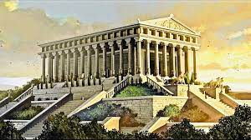
Temple of Artemis

Slide 46
7
This company started out by mailing it’s products back in 1998. The envelopes were first white and then yellow, but settled on the iconic red since 2001.
Though this company has long pivoted to a different means of product delivery, the last envelope was mailed in September of this year, with the company informing the customers that there was no need to return them
Which company?

Slide 47
Netflix

Slide 48
8
The study that won the 2012 Ig Nobel in Fluid Dynamics investigated a common, quite annoying occurrence that had at the time never undergone comprehensive investigation.
They studied the circumstances that lead to liquid dispersion from a container, by testing out different velocities of biomechanical locomotion and initial fluid levels, which when combined with the low-viscosity of the fluid, leads to the annoying (everyday) occurrence.
Which phenomenon did they study ?

Slide 49

The Science behind coffee spilling while walking with a cup

Slide 50
9
In the Phineas and Ferb episode titled “The Lake Nose _______”, Dr. Doofenshmirtz attempts to remove all the Zinc from Lake Nose which results in an entity becoming weaker and worn out as it requires Zinc for its sustenance.
Phineas and Ferb find this entity and befriend it. At the end of the episode, Candace accuses her brothers of not bringing the proof of the the entity’s existence to make her look foolish.
Which famous real life entity is the title a pun of?

Slide 52

Loch Ness Monster
(Lake Nose Monster)

Slide 53
10
A novel from Walter Tevis first came out in 1982, but only became a New York Times’ bestseller after more than 3 decades of its release.
This surge in popularity came about because of a successful screen adaptation, but there have been earlier unsuccessful attempts to adapt the book, the most recent of which was supposed to be directed by Heath Ledger.
Which Novel?

Slide 54
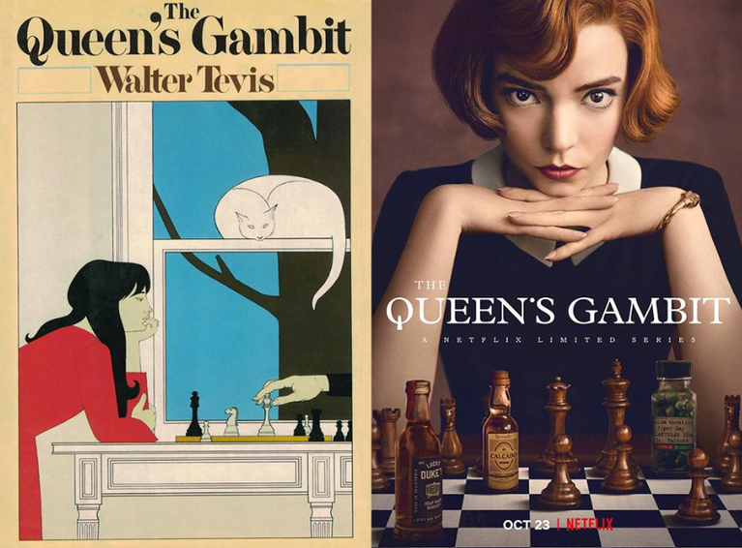

Slide 55
11
The site in New Jersey of a famous 20th century mishap is today outlined with a chain and bronze plaque, which were dedicated on the 50th anniversary of the tragedy.
The event was well documented since this would’ve been a major milestone, which flocked in huge crowd.
What happened here?

Slide 57
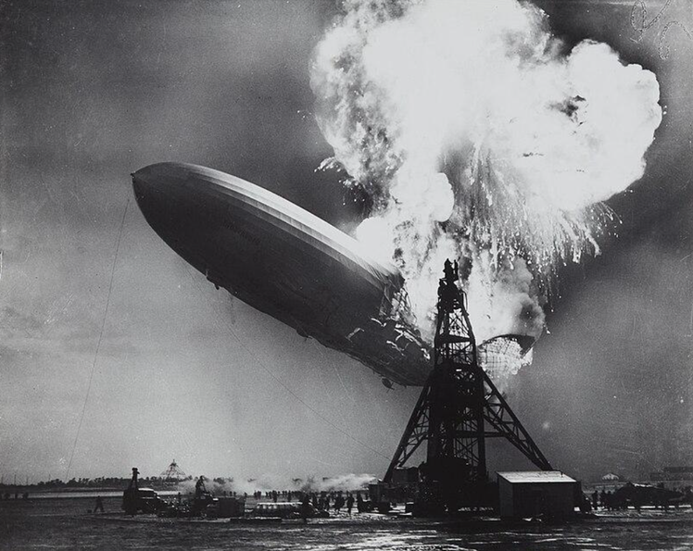
Site of the Hindenburg Disaster

Slide 58
2 pointers

Slide 59
12
Before AI generated images and collages became mainstream, Salvador Dali created a masterpiece that gives the illusion of 2 paintings in one.
Titled “Gala Contemplating the Mediterranean Sea” ; it demonstrated the low quantity of information needed to represent a recognizable individual face. The painting is a homage to America itself, giving him refuge during the turmoil of the Spanish Civil War and WW2.
ID the American face (1)
Given it’s simplified shapes & colour gradations, it’s also a homage to another painter which similar abstract style. ID the painter (1)

Slide 60
Gala Contemplating the Mediterranean Sea

Slide 61

Gala Contemplating the Mediterranean Sea which at Twenty Meters Becomes the Portrait of Abraham Lincoln-Homage to Rothko

Slide 62
13
Xs have always been native to India and have been a part of Indian culture for centuries.
Y was a military general who of the Portuguese established colonies in India in the 15th centuries. Naturally, the colonizers had their eyes on the native Indian X and lots were exported to Europe.
However, Y and the European elites had a different taste and they preferred their X to be firm and sweet so that they could be cut and served on the tables.
This is where the Portuguese started using the technique grafting on X plants. They would eventually stumble upon a variant that was to the liking of Y, naming the variant after him.
ID X and Y.

Slide 63
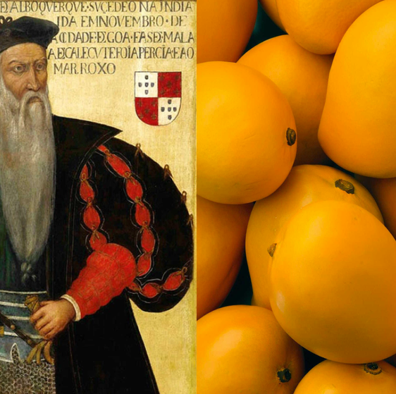
X - Mangifera indica (Mango)
Y - Alfonso

Slide 64
14
One of the most memorable victories of Lee Hyung-Taik, a professional tennis player, is against Goran Ivanisevic. Lee was leading 7-5, 6-7, 3-1 and victory was imminent, it was visible that Ivanisevic was running out of patience.
Ivanisevic then did something, that he had been doing a few times in this match, but little did he know that this time he couldn’t afford to do it, which led to Ivanisevic losing the match in the most embarrassing manner.
What had he been doing all match?
What was the reason for the embarrassing defeat?

Slide 65
Breaking Tennis Rackets
Ran out of Rackets to break

Slide 66
15
The podcast "The ____ __ _______" is an exploration series hosted by two historians, Dominic Sandbrook and Tom Holland (different Tom Holland).
In each episode, they delve into a different topic in history, frequently featuring guest experts. The podcast takes its name from a familiar expression used to signify that subsequent events are widely recognized/well known and require no further elaboration.
What’s the title of the podcast?
Episode 267 of this podcast is titled ‘_____: The Roar of the Red Dragon’, which country is this episode about? (hint: not an asian country)

Slide 67

The Rest is History
Wales

Slide 68
16
The Stepan Company is a chemical manufacturer and has about 2000 employees. They own a facility in New Jersey and are the only DEA authorised entity in the US to import a certain species with the intention of extracting a chemical from it, which is used for medical purposes.
After processing, the chemical-free extract is sold to a very popular company for use in its products, whose name is based the common name of this species. Which huge company is this?
What asset of this company is hidden away behind this vault? (Image follows)

Slide 70
Coca-Cola
Original Recipe stored in the vault

Slide 71
17
The flag of a certain state ‘X’ of a economically prosperous country is rather weird and has a very rich history behind it. The state itself has a GDP of $600 Billion (only 20 countries have a higher GDP) because of the presence of numerous companies and industries.
One of these companies’ logo is derived from this flag, debunking the myth that the logo is resonant of the company’s aviation beginnings.
A team from this region has also incorporated this flag into its logo, after an earlier design had to be stopped because reasons.
ID the state X (1)
Which company and which team (0.5+0.5)

Slide 73


X - Bavaria
BMW
Bayern Munich

Slide 74
ID

Slide 75
18

Slide 76
18

Slide 77
19

Slide 78
19

Slide 79
20

Slide 80
20

Slide 81
21

Slide 82
21

Slide 83
22
Joy, power, anguish, respect, pride, bravery, glory, wonder, and passion - Navarasa - illustrate the emotional spectrum experienced by fans during the drama and excitement of a global event. This led to the creation of the logo of this event.
Which event?

Slide 84

ICC World Cup Logo

Slide 85
23
Shiny Happy People by R.E.M was selected as the theme song for a peppy sitcom. But the band declined and another song was chosen.
Which show? (Song follows)

